Slide 1
Effective Presentation Skills

Slide 2
Learning objective
Prepare presentations interesting, persuasive and to communicate key messages
Identify the best ways to interact with the audience, control and handle challenging individuals
Handle difficult situations and influence the audience

Slide 3

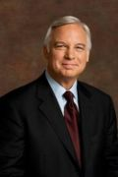
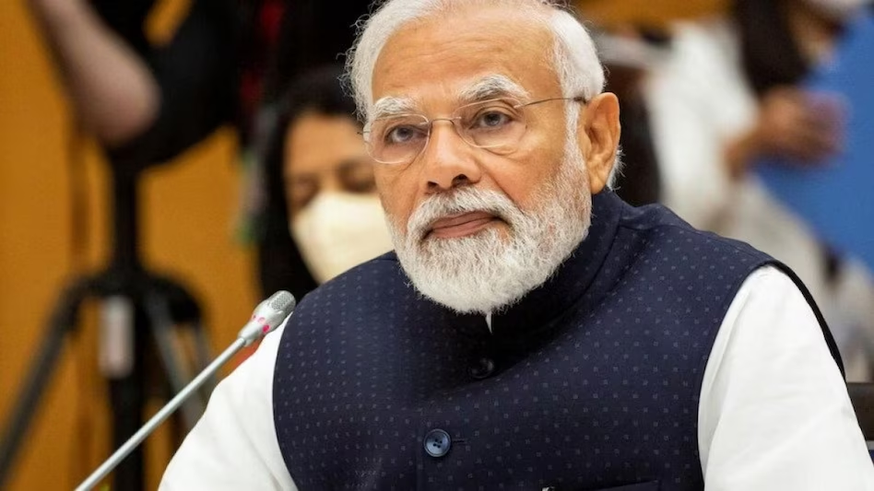
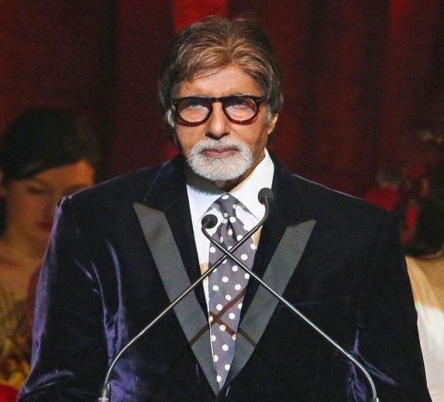
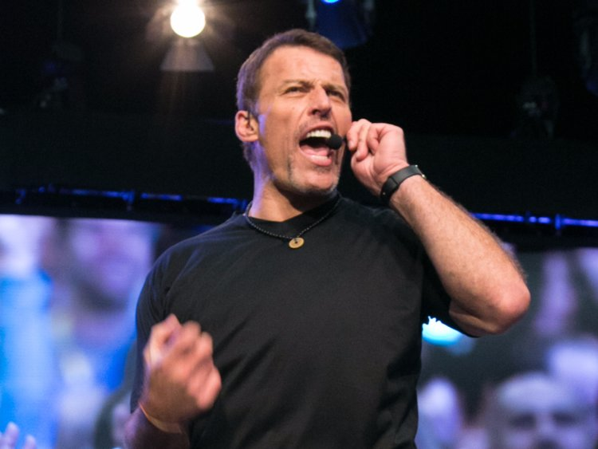
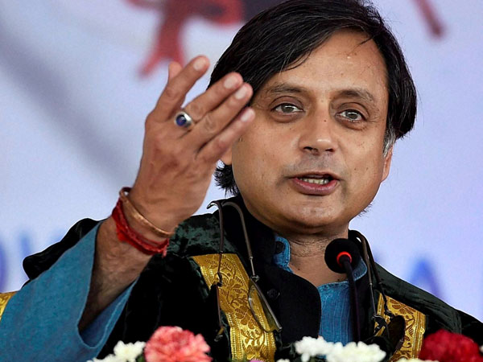

Slide 4
Polished Prose
Elegant Logic
Highly Developed Craft
Smooth Delivery

Slide 5

“There are always three speeches, for every one, The one you practiced, the one you gave, and the one you wish to give.”

Slide 6
Case Study
Ramesh is promoted as an Assistant Manager in technosoft Pvt. Ltd. He has got an opportunity to travel onsite for project presentation. He is excited about this opportunity and bit nervous about the same. He will be travelling to Bangalore for 3 hours of presentation. What advice will you give it to him?

Slide 7

4 P’s of Presentation.

Slide 8
BEST WAYS TO START A PRESENTATION
STORIES
QUESTIONS/ CASE STUDY
VIDEOS
ACTIVITY
QUOTE
EXPERIENCE

Slide 9
PLAN
PREPARE
PRESENT
PRACTICE

Slide 10



Slide 11
6 main purposes of presentation
Instruct
Stimulate
Inform
Motivate
Entertain
Persuade

Slide 12

TIME ALLOCATION

Slide 13
AUDIENCE
Why am I giving the presentation?
What do I want the audience to gain from the
presentation?

Slide 14
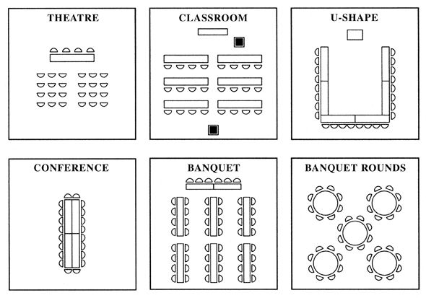

Slide 15
3 Essentials of Successful Presentation
EDUCATE: The audience should learn something from your speech or presentation
ENTERTAIN: The audience should enjoy your speech or presentation
EXPLAIN: All parts of your speech or presentation should be clear to your audience

Slide 16
Audience Attitude
Like you and like your subject
Like you but dislike your subject
Dislike you but like your subject
Dislike both you and your subject
Like or dislike you but be neutral about your subject
Be neutral about you and like or dislike your subject
be neutral about you and your subject

Slide 17
Presentation planning checklist
Does your introduction grab the participant’s attention and explain your objectives?
Do you follow this by clearly defining the points of the presentation?
Are the main points in logical sequence?
Do the main points flow well?
Do the main points need support from visual aids?
Does your closing summarize the presentation clearly and concisely?
Is the conclusion strong?
Have you tied the conclusion to the introduction?

Slide 18
Prepare
PREPARING YOURSELF
PREPARING MATERIAL

Slide 19
Preparing Material

Slide 20
The Golden Circle
WHY ?
HOW ?
WHAT ?

Slide 21
Questions
WHY
WHAT
WHO
HOW
WHERE
WHEN

Slide 22
Preparing Yourself

Slide 23


First Impression
Smile please
Dress Well
Use a right formal combination
Be proactive
make your style
Be humble

Slide 24
Practice
1. MIRROR EXERCISE
2. RECORDING SESSION
3. TAKE THE FEEDBACK FROM AUDIENCE
4. FREE DEMOS

Slide 25
Present
1. Deliver the experience with
( Authority, Confidence, Energy)

Slide 26
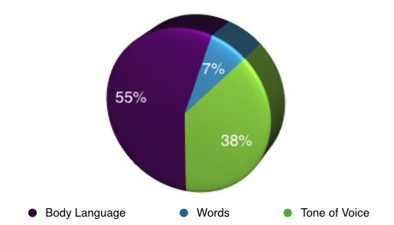
UNDERSTANDING THE 7-38-55 RULE

Slide 27
SPEAKING POWERFULLY
PITCH
PACE
VOLUME
MODULATION
TONE

Slide 28
Presentation Delivery Checklist
Are you knowledgeable about the topic covered in your presentation?
Do you have your notes in order?
Where and how will you present? (Indoors, outdoors, standing, sitting etc.)
Have you visited the presentation site?
Have you checked your visual aids to ensure they are working and you know how to use them?

Slide 29
Tips for achieving Excellence

Slide 30
Learning Styles
Auditory Learners
Visual Learners
Kinesthetic Learners

Slide 31
TYPES OF AV AIDS
Low Complexity: Handouts, writing board, flip-chart
Medium Complexity: Slide projector, OHP, Audio system
High Complexity- VIDEO, Multimedia, Computer graphics

Slide 32
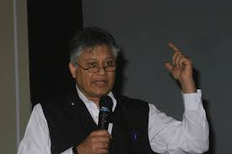
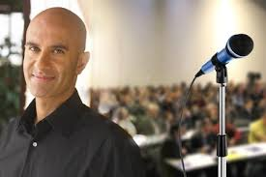
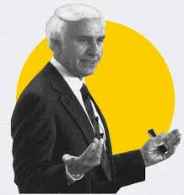
Have a role model

Slide 33
KISS
Keep
It
Short
&
Simple

Slide 34
Tell Them Structure

Slide 35
6 * 7 Rule
No more than 6 lines per slide.
No more than 7 words per line.

Slide 36
Rapport building
People are interested in themselves and not in you
Talk to them and let them talk about themselves
WIIIFM
Common Ground/Interest
Small talk
Transparency
Matching and Mirroring

Slide 37
If you want the learner to understand
Articles
Lectures
Diagrams
Instruction
Videos.

Slide 38
If you want the learner to do:
Case studies
Demonstration
Role plays
Exercises
Work sheets
Actual skill

Slide 39
If you want the learner to change their values & attitudes.
Role plays
Games
Self-analysis/Awareness
Activities

Slide 40
If you want the learner to develop a capacity for creativity:
Brainstorming
Activities
Unstructured
Games
Problem-solving
Activities

Slide 41
People will forget what you said, people will forget what you did, but people will never forget how you made them feel
Maya Angelou

Slide 42
VIDEO LINK
https://www.youtube.com/watch?v=uvsuAZFem88&t=266s – steve jobs
https://www.youtube.com/watch?v=2-ntLGOyHw4 – present like steve jobs
https://www.youtube.com/watch?v=mpfxsvBPWEs - Sundar Pichai

